Slide 1
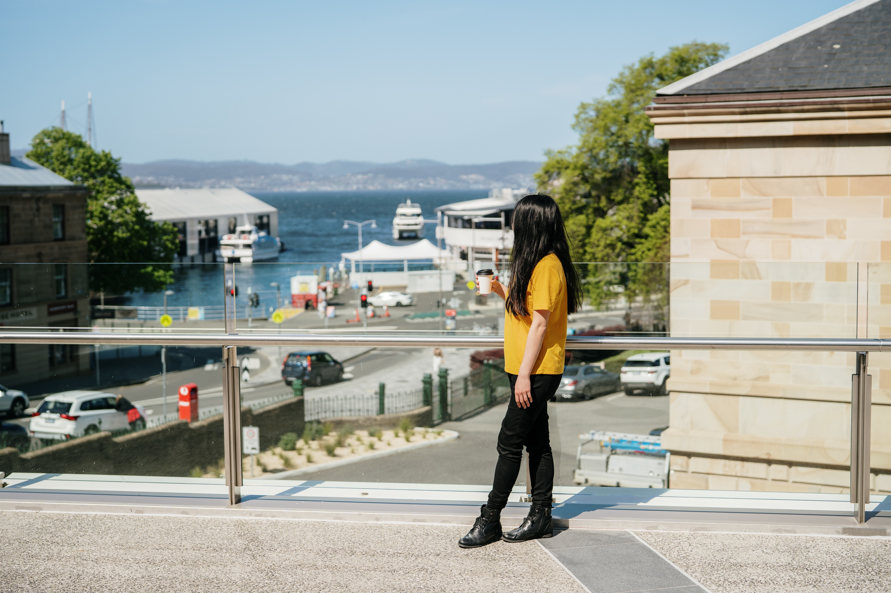
Tasmanian Skilled Migration State Nomination Program
Information Webinar
12 December 2023
MIGRATION TASMANIA
You have successfully entered the webinar.
We will commence shortly.
WWW.MIGRATION.TAS.GOV.AU

Slide 2
Today’s topics
Nomination, ROI and application status
Subclass updates
Processing tips & reminders
Business Tasmania information
Christmas shut down
Audience Questions
Please wait until end of presentation to send your question because it may be answered

Slide 3
ROI and Application Update – As at 11 December 2023
Have already used over 50% of quota for sc 190
Not quite used up 50% of quota for sc 491
893 ROIs on hand
Subclass 190 - 512
Subclass 491 - 381
Program is very competitive – No Orange Pass holders invited at this time
Oldest nomination application not allocated for processing lodged on 25 November 2023
Quota | Nominations recorded | Applications not yet finalised (including invitations not yet accepted and decisions not notified) | Active ROIs remaining (not yet invited)
Total – 1,200 places | 583 | 31 | 893
Subclass 190 - 600 places | 343 | 21 | 512
Subclass 491 - 600 places | 240 | 10 | 381

Slide 4
Subclass 190 update
Extremely competitive. More demand for subclass 190 than 491
Over 220 Green Pass holders in sc 190 waiting for invitation and less than 260 nomination places left
We want to invite all Green Pass ROIs to apply for nomination, but with restricted quota, may not happen
We are not able to invite Green Pass holders within 8 weeks of ROI lodgement
May not be able to invite all Green Pass holders before 6 months & ROI lapses
Quite probably run out of 190 places by early May

Slide 5
A little more room here to spare – 240/600 nominations used
Receiving approximately 8 – 12 Gold and Green ROIs per week. All Green Pass holders are being invited within 3 weeks.
Have not invited any Orange Pass holders – might be some room to do so in April / May
May want to consider lodging 491 ROI, if eligible for 190?
Planning on sending out invitations until mid-May
Subclass 491 update

Slide 6
Onus is on applicant to provide all information/documentation (eg all payslips and bank statements where salary deposited)
Incomplete applications may be declined without a request for information
No re-nominations this year – Will need to reapply with ROI
Email us (skilled@migration.tas.gov.au) before you lodge ROI & provide full picture of your situation
False information or claims may lead to refusal of application, or withdrawal of nomination at any time up until visa grant
Processing tips & reminders

Slide 7
Business Support in Your Language
The Business Tasmania service includes (but is not limited to):
business-related queries
license and permit information
funding opportunities offered by government
business events and networking opportunities
contemporary online tools, templates, and checklists
access to free business advice and support
digital coaching
Contact: 1800 440 026 press 0 for language assistance.

Slide 8
Migration Tasmania Christmas shut down
Friday 22 December will be last working day of 2023
Week between Christmas and New Year, office will be closed
We will still accept emails, but response will be delayed
Back in office 2 January 2024
Limited staffing – Possible delays to email responses

Slide 9
Question Time
MIGRATION TASMANIA
Email: skilled@migration.tas.gov.au
WWW.MIGRATION.TAS.GOV.AU

